Slide 1
Section 10.4 Contact Networks
Emelia Blankenship

Slide 2
Goal
Offer “direct empirical evidence of the significance of the underlying degree heterogeneities.” By “inspecting the structure of several contact networks encountered in epidemic phenomena”

Slide 3
Sexually transmitted Diseases

Slide 4
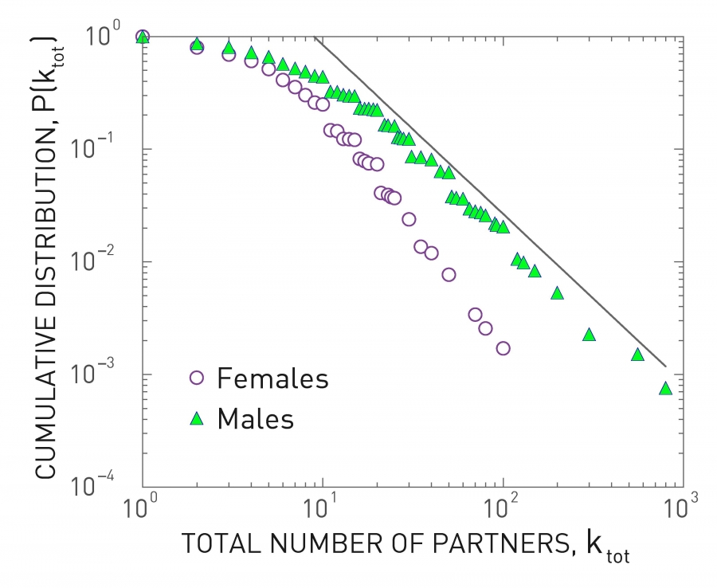
Sex Web
Interview/survey random swedes for their estimated number of sexual partners
Well approximated with a power law! Scale-free
“This was the first empirical evidence of the relevance of scale-free networks to the spread of pathogens.”
Notes:
Scale Free – Most individuals have relatively few sexual partners, a few individuals had hundreds. Graph shows men with more partners, may be due to social bias causing exaggeration or suppression of numbers

Slide 5
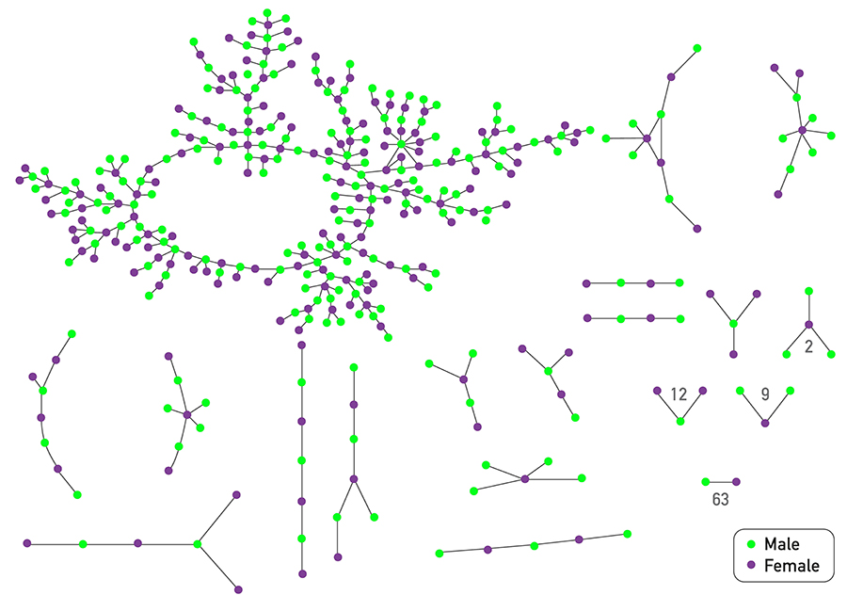
Sexual Hubs
HIV/AIDS
  Flight attendant with ~250 homosexual partners
High school romantic networks

Slide 6
Airborne Diseases
Global level and local level contact networks
Notes:
Need set of individuals an individual comes into contact with
Mobile phones were helpful

Slide 7
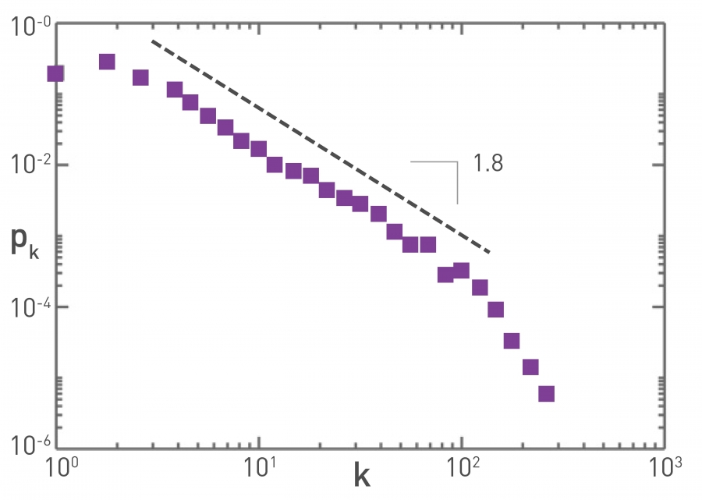
Global Travel Network – Air Travel
The most studied mobility data – determines speed at which a pathogen moves around the globe
Air Transport Association database: 3,100 largest airports and 17,182 direct flights from 2002
Notes:
Some airports have relatively low traffic while others have extraordinary traffic
Air transport association accounts for 99% of worldwide traffic

Slide 8
Local Contact
Face to face interactions
Digital badges (RFID), Bluetooth, or other technologies especially useful for local contact data
Location networks
  Mall/supermarket/school as hubs
  Large number of homes/offices
Notes:
Disease reaches hub = rapidly reach other locations

Slide 9
RFID Badges
Used to monitor the interactions between high school students and teachers during a 2 day period
Only captures contact when individuals facing each other leading to an exponential degree distribution
Duration of contact and the cumulative time two individuals have spent together follows power law distribution
Could be improved with mobile phones

Slide 10
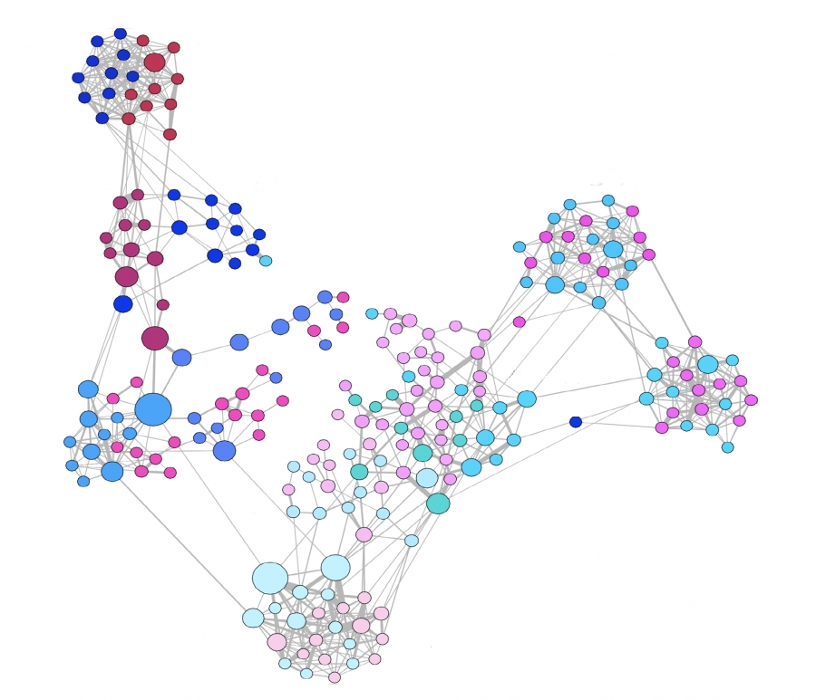
Face to Face Interactions
232 Students
10 Teaches
10 Classes
2 Days

Slide 11
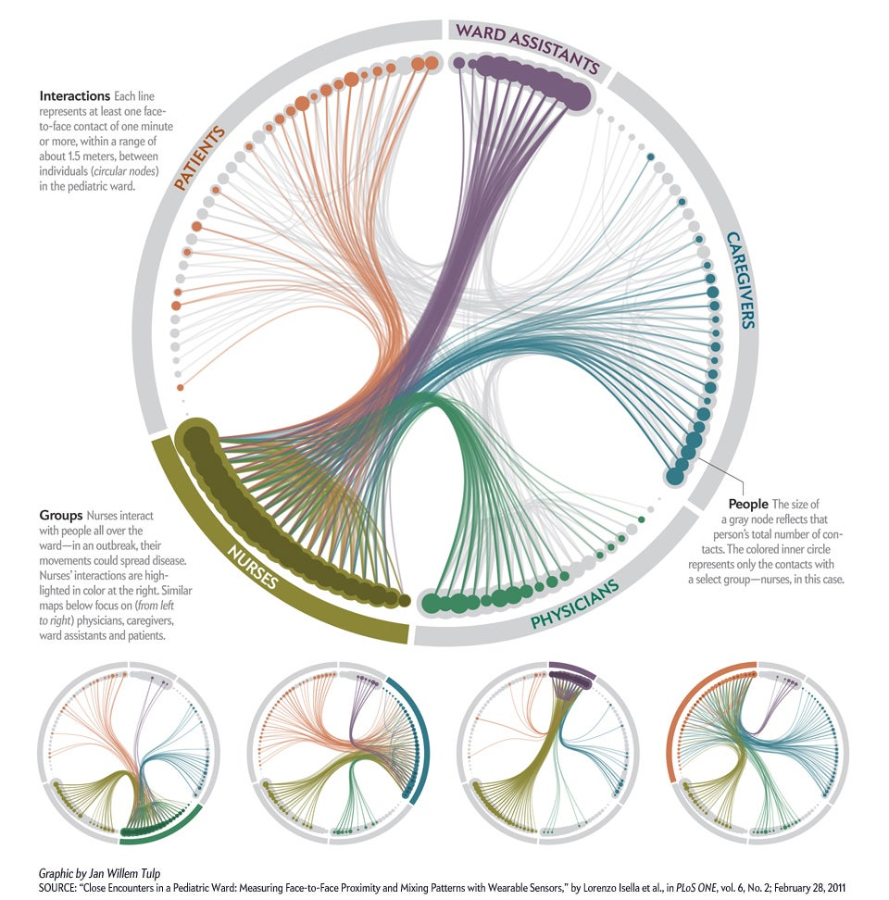
Close Encounters in a Pediatric Ward
119 people in pediatric ward, ~16,000 contacts over 1 week
1.5m and 20s
9-16th of Nov. 2009, Italy
Nurses interacted with the widest variety of people
Isella L, Romano M, Barrat A, Cattuto C, Colizza V, et al. (2011) Close Encounters in a Pediatric Ward: Measuring Face-to-Face Proximity and Mixing Patterns with Wearable Sensors. PLoS ONE 6(2): e17144. doi:10.1371/journal.pone.0017144

Slide 12
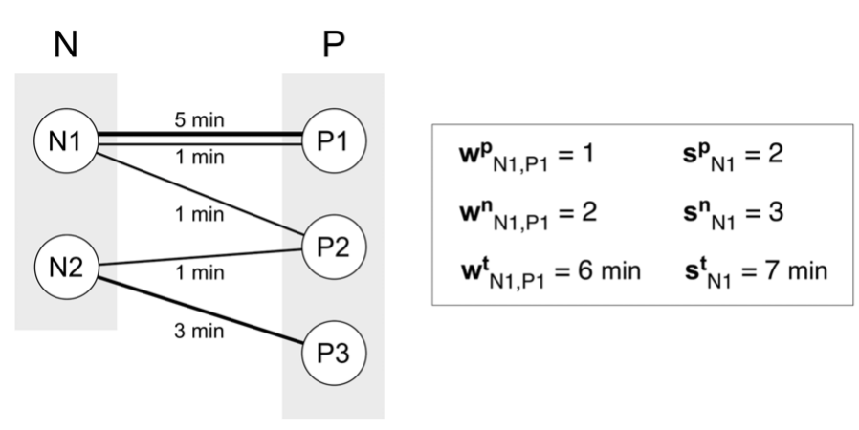
Analysis and Results
~20 contacts per participants per day
The minimum number of contacts is observed for physicians (8%)
95% of the contacts have a cumulated duration wt of less than 4 minutes
Time spent in close proximity between pairs of patients/visitors or health care workers and non-health care workers are extremely small
Proves class specific behaviors
Used to target patients – now know to target nurses for tailored interventions
Wp = occurrence of contact (0/1)
Wn = frequency of contact
Wt = cumulative duration of contact
Sp = number distinct contacts
Sn = number of contacts
St = cumulative time in contact
Width = duration of contact, multiple links = higher frequency

Slide 13
Digital Viruses

Slide 14
Computer Viruses
Just as much diversity as biological viruses
Email Attachments
  Mails a copy of itself to address book making the email network the relevant contact network (Scale free)
IP addresses – Spread on fully connected networks

Slide 15
Mobile Phone Viruses
Bluetooth
MMS
Passes a copy of itself to all susceptible phones with a Bluetooth connection within physical proximity
Significant degree heterogeneity
Sends a copy of itself to the contact list
Exploits phone number contact network – a scale free network with a high degree exponent

Slide 16
Questions?
Thanks!

